Slide 1
Explain how index numbers are useful in business and economic analyses.
Construct and interpret:
  Simple relative price, quantity and value indexes
  Simple aggregate indexes for price and quantity
  Weighted aggregate price indexes.
Explain how the Consumer Price Index is constructed.
Change the base period for an index.

Slide 2
Base period
Simple relative index
  for price
  for quantity
  for value
Simple aggregate index
  for price
  for quantity
Weighted aggregate price index
  Paasche Index
  Laspeyres Index
  Fixed-Weight Aggregate Price Index
Consumer Price Index (CPI)

Slide 3
What are index numbers?
Index numbers:
  are time series that focus on the relative change in a count or measurement over time.
  express the count or measurement as a percentage of the comparable count or measurement in a base period.

Slide 4
Base Periods for Index Numbers
The base period is arbitrary but should be a convenient point of reference.
The value of an index number corresponding to the base period is always 100.
The base period may be a single period or an average of multiple adjacent periods.

Slide 5
Applications of Index Numbers in Business and Economics
A price index shows the change in the price of a commodity or group of commodities over time.
A quantity index shows the change in quantity of a commodity or group of commodities used or purchased over time.
A value index shows a change in total dollar value (price • quantity) of a commodity or group of commodities over time.

Slide 6
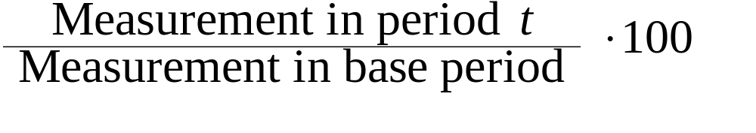
Simple Relative Index
A simple relative index shows the change in the price, quantity, or value of a single commodity over time.
Calculation of a simple relative index:
Index in period t =

Slide 7
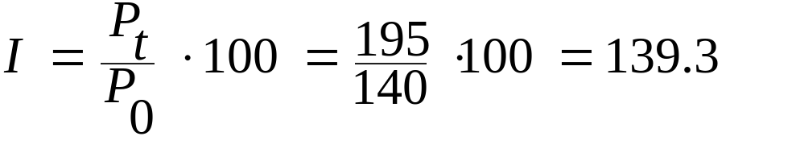
Example: Simple Relative Price Index
Price Index Price Index
Year Price 1980 as base year 1990 as base year
1980 $140 100.0 58.3
1985 195 139.3 81.3
1990 240 171.4 100.0
1995 275 196.4 114.6
Computation of index for 1985 (1980 as base year):

Slide 8
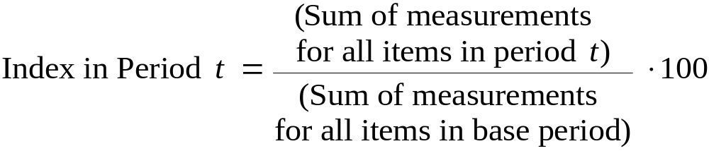
Simple Aggregate Index
A simple aggregate index shows the change in the prices, quantities, or values of a group of related items. Each item in the group is treated as having equal weight for purposes of comparing group measurements over time.
Calculation of index number:

Slide 9
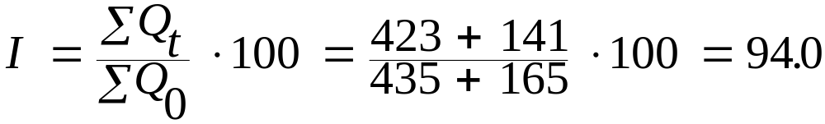
Example: Simple Aggregate Quantity Index
Simple Aggregate Index,
Cars Trucks for Cars & Trucks Sold
Yr Sold Sold (1995 as base yr)
1994 423 141 94.0
1995 435 165 100.0
1996 440 184 104.0
1997 455 215 111.7
Illustration of computation of index for 1994:

Slide 10
Weighted Aggregate Index
Simple aggregate index numbers may not be valid in comparing groups of items because of differences in volumes of the items used or differences in the units of measurement.
In a weighted aggregate index, the measurement of each item is multiplied by an appropriate weighting factor before being aggregated with other items to obtain a combined measurement.

Slide 11
Weighted Aggregate Index:
Selecting Weights
To make sure that the changes indicated by the index numbers focus on the aspect of interest (e.g., price or quantity), the same weighting factors must be used to aggregate measurements in the selected period and the base period.
  In weighted aggregate price indexes, the corresponding quantities are often used as weighting factors.
  In weighted aggregate quantity indexes, the corresponding prices are often used as weighting factors.

Slide 12
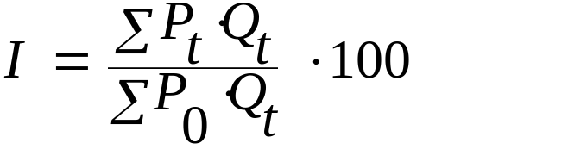
The Paasche Index
A weighted aggregate price index where the quantities of the items used in the period of interest are used as weighting factors.
Calculation of index for period t:
where P_{t} = price of item in period t
P₀ = price of item in base period
Q_{t} = quantity of item in period t
Note that quantities in period t are used to determine the weighted sum of base period prices.

Slide 13
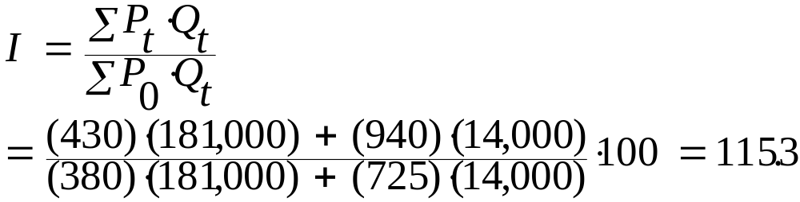
Example - Paasche Index
Paasche index for airline tickets for 1997 using base year of 1990:
Product Price, 1990 Price, 1997 Quantity, 1997
Coach $380 $430 181,000
First Class 725 940 14,000
Computation of index for 1997:

Slide 14
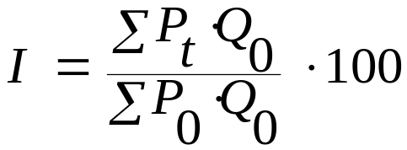
Laspeyres Index
A weighted aggregate price index where the quantities of the items used in the base period are used as weighting factors.
Calculation of the Laspeyres index for period t
where P_{t} = price of item in period t
P₀ = price of item in base period
Q₀ = quantity of item in base year

Slide 15
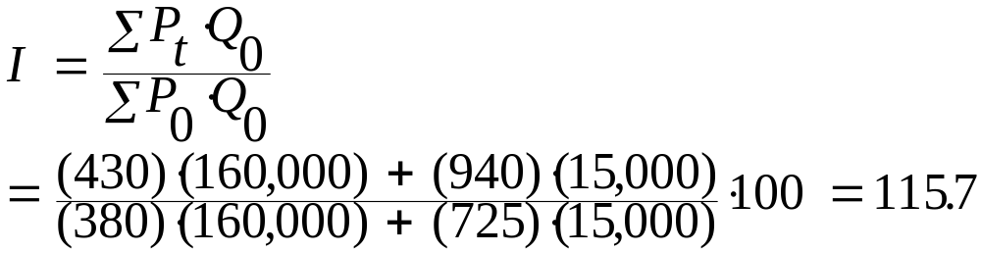
Example: Laspeyres Index
Laspeyres index for airline tickets for 1997 using base year of 1990:
Product Price, 1990 Price, 1997 Quantity, 1990
Coach $380 $430 160,000
First Class 725 940 15,000
Computation of index for 1997:

Slide 16
Consumer Price Index
A weighted aggregate price index used to reflect the overall change in the cost of goods and services purchased by a typical consumer.
Applications:
  Indicator of rate of inflation
  Used to adjust wages to compensate for lost purchasing power due to inflation
  Used to convert a price or wage to a real price or real wage to show the equivalent amount in a base period after adjusting for inflation.

Slide 17

Example: The CPI as Deflator
Suppose a person was earning $40,000 per year in September 1997, when the CPI was 161.2 (base year: 1982-84 ). What was the person’s real income in its 1982-84 equivalent?
Real income in period t =
Income in period t •
Real earnings in 1997 = $40,000 • 100/161.2
= $24,814

Slide 18
Example: The CPI as Deflator
Suppose the same person was earning $36,500 per year in 1993, when the CPI was 144.5 (base year: 1982-84 ). What was the person’s real income in its 1982-84 equivalent?
Real earnings in 1993 = $36,500 • 100/144.5
= $25,260
The purchasing power of the person’s earnings was higher in 1993 than in 1997.

Slide 19
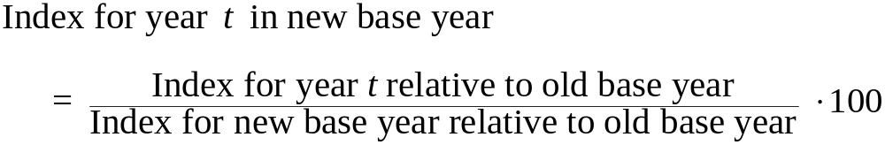
Shifting the Base of an Index
For useful interpretation, it is often desirable for the base year to be fairly recent.
To shift the base year to another year without recalculating the index from the original data:

Slide 20
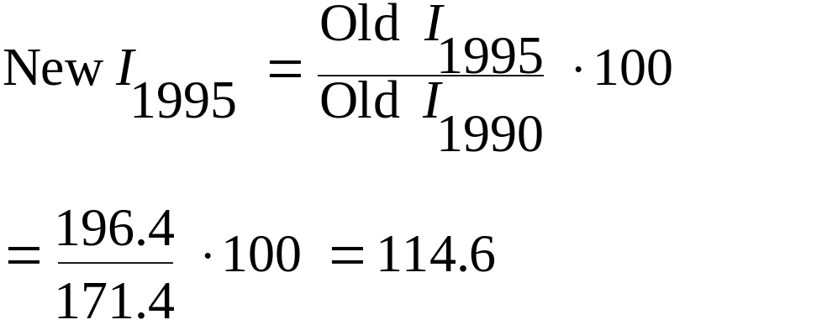
Example: Shifting a Base Year
To shift a base year from 1980 to 1990:
Price Index Price Index
Yr 1980 as base yr 1990 as base yr
1980 100.0 58.3
1985 139.3 81.3
1990 171.4 100.0
1995 196.4 114.6
An Illustration:

